Slide 1


Library Management System REST Implementation
Our library management application offers a comprehensive solution to handle all your book-related needs. From searching for titles to managing user information and borrowing processes, this platform puts the power in your hands.
Bilge Kağan ÖZKAN - Tuna ÖZTÜRK

Slide 2




User Features
1
2
3
Borrow Books
Request a book from librarian by providing your student ID and the book's ID.
View User Info
Search Books
Access your personal book history, due dates, and fees.
Easily find books by name, author, or ID.

Slide 3



Librarian Features
Book Management
User Management
Add and remove books.
Monitor and manage user borrowing and returning activities.

Slide 4



Book Details
Book Information
Availability
Borrowing Process
View the title, author, type, and location of a book.
Check if the book is currently available or checked out.
Initiate the borrowing process by providing your student ID.

Slide 5
SOAP vs. REST
login()
getBookById(int id)
searchBooksByNameAndAuthor()
getUserInfo(int studentId)
GET /login
GET /book/{bookId}
GET /book/{name}/{author}
GET /user/info/{studentId}
borrowBook()
addBook(Book book)
returnBook()
POST /book/borrow
POST /book/add
PUT /book/return
deleteBook(int id)
DELETE /book/{bookId}

Slide 6
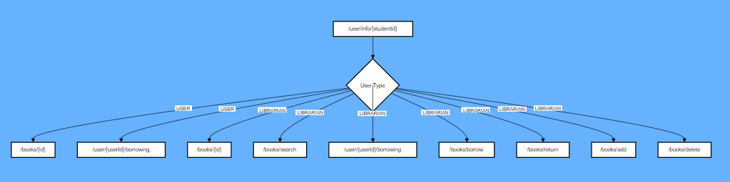
getUserBorrowingInfos

Slide 7
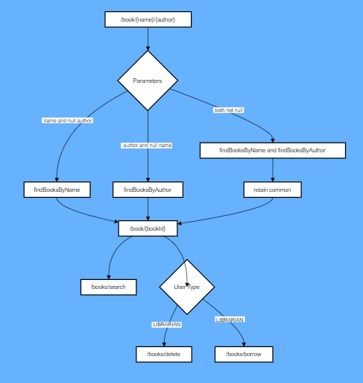
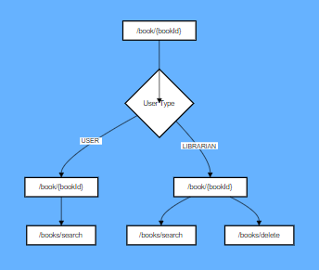
getBookById
searchBooks

Slide 8
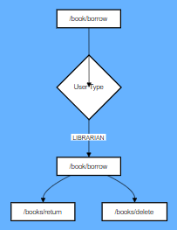
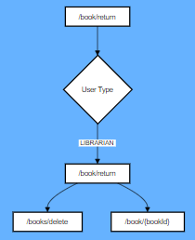
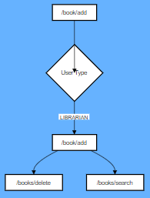
addBorrowBook
addReturnBook
addBook

